Slide 1

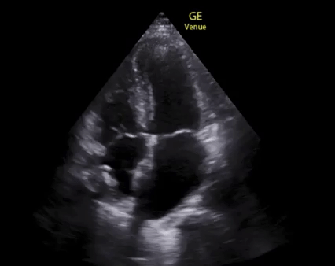
Echo-Based Cardiac Function Assessment
Scientific Computing
Faculty of Computer and Information Science
Ain Shams University

Slide 2






Team Members
Supervisors
Dr. Manal Mohsen Tantawi
T.A. Radwa Reda Hossieny
Abanoub Gamal
Kerolos Waheed
Kerolos Nabil
Yassa Kamille
Kerolos Helal
Ganna Muhammed

Slide 3
Agenda
01
Problem Definition
Literature Review
Motivation
Objectives
System Architecture
08
05
Conclusion
02
09
06
Future Work
03
Methodology
10
07
0
Tools
04
Experimental Results
11
References

Slide 4
Problem Definition
01

Slide 5
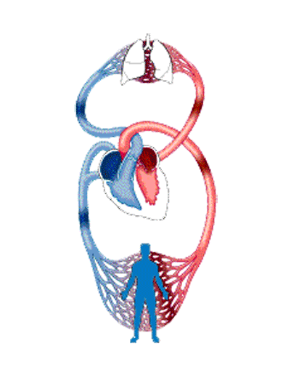
Problem Definition
The heart is the center of circulatory system, contracts to pump blood and relaxes to allow filling. The left ventricle's role in pumping oxygenated blood makes it pivotal; its failure can impair multiple organ systems. Cardiomyopathy can lead to heart failure or sudden cardiac arrest, necessitating critical intervention.

Slide 6
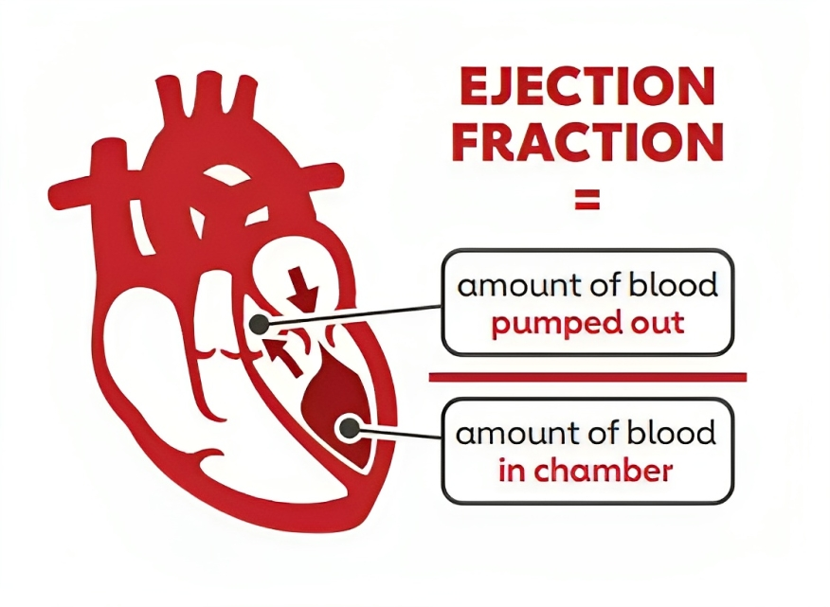
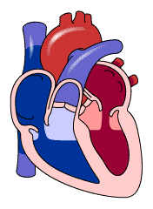
Problem Definition
Echocardiograms are vital diagnostic tools employing sound waves to visualize heart. Left Ventricle Ejection Fraction (LVEF), measuring blood pumped per heartbeat, is crucial in assessment.

Slide 7
02
Motivation

Slide 8
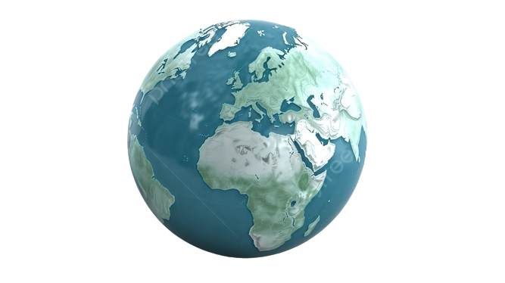
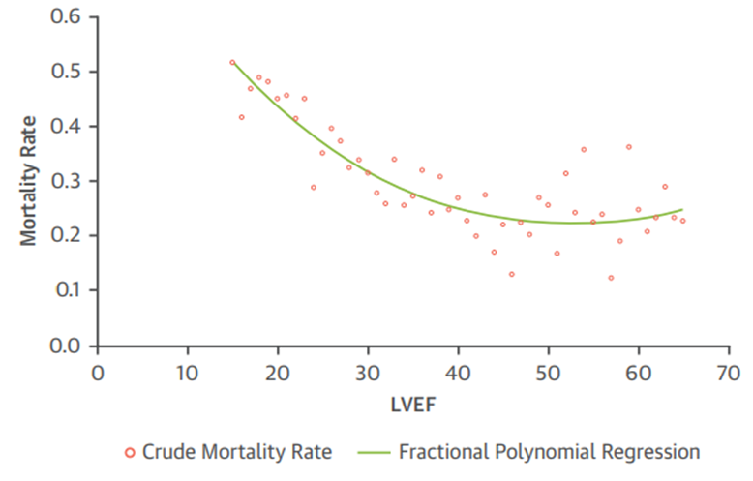
Motivation
17,900,000
Approximately deaths around the world annually due to heart disease
This accounted for nearly one-third of all global deaths, showing an overall rise, Ejection Fraction has a direct effect on death rate.

Slide 9
03
Objectives

Slide 10

Objectives
Development a powered system capable of accurately assessing cardiac function and rapidly estimating the Ejection Fraction of left ventricle (LVEF) from Echocardiogram videos to determine whether the patient’s heart is normal or abnormal.

Slide 11
System Architecture
04

Slide 12
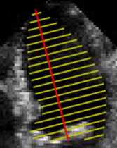
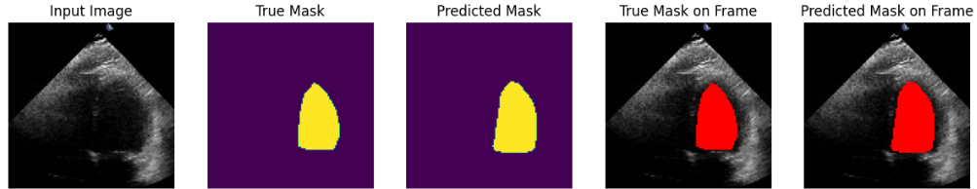
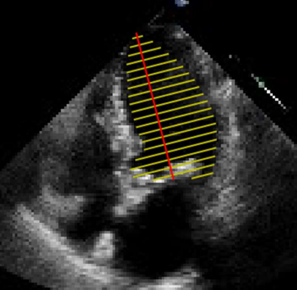
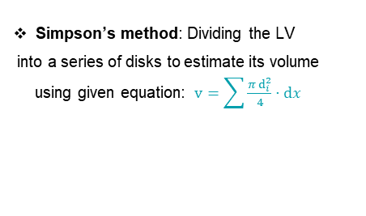
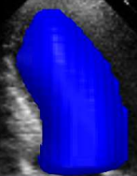
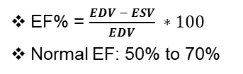
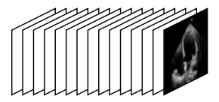
System Architecture
U-Net Model :
Normal
Video Analysis
Detect
(ES –ED) frames
Get the binary mask to left ventricle
Landmarks Detection
Calculate Volume
Calculate Ejection Fraction
Thresholding
Classification
Abnormal
frames
Transformer ResNet-BERT

Slide 13
Literature Review
05

Slide 14
Literature Review
Authors | Dataset | Pre-Processing | Calculate Volume | Boundary box detection | Classification Model | Evaluation
David Ouyang et al. [1] | EchoNet Dynamic Size= 10,030 | Segmentation Down Sampled (112 * 112) | _ | _ | EchoNet-Dynamic | MSE= 7.93% R2= 0.81
Hadrien Reynaud et al. [2] | EchoNet Dynamic, Size= 10,030 | _ | _ | _ | ResNet BERT | MAE= 7.85% R2 = 0.52
Grant Duffy et al. [3] | EchoNet Dynamic, Size= 10,030 | _ | _ | _ | DeepLabV3 | MAE= 8.55% R2= 0.61
Xin Liu et al. [4] | EchoNet Dynamic, Size= 10,030 CAMUS, Size= 500 Subjects | Resampled 256*256 | _ | _ | DpsNet DpsNet-V2 | DC= 0.92

Slide 15
06
Methodology

Slide 16
Dataset
EchoNet-Dynamic
Dataset “Echo-Net Dynamic”,
It contains 10,030 echocardiogram videos of varied length, frame rate, and image quality, all containing 4-chamber views(112X112).
The videos represent at least one full heart cycle, but most of them contain three or more cycles.
In each clip, however, only one cycle has the ES and ED frames labelled.

Slide 17

Detecting (ES-ED) Frames
CNN
Convolution Neural Networks is a type of deep learning supervised algorithm, they are powerful for tasks like image classification. They’ve the ability for automatically learning hierarchical representations of features from raw pixel data. This allows CNNs to effectively capture patterns and features.

Slide 18
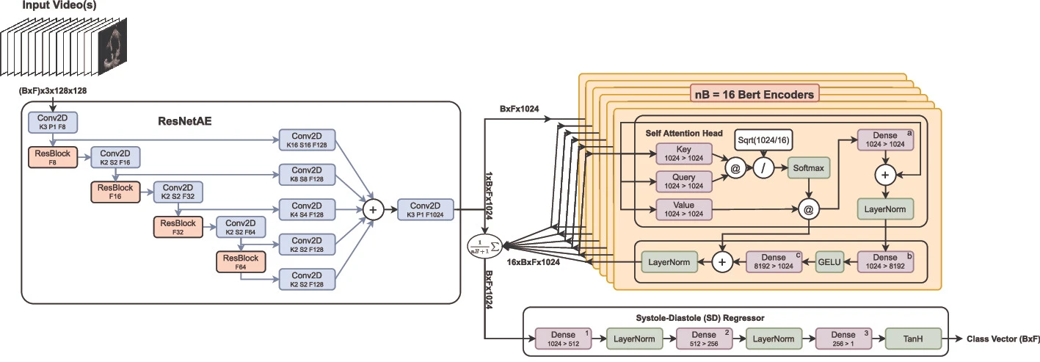
Detecting (ES-ED) Frames
Transformer
The module consists of ResNet encoder which reduces the dimensionality for Bert which has self attention mechanism that makes it a sequence-to-sequence transformer supervised deep learning model that can effectively capture long-range dependencies within the temporal sequences of echo videos.

Slide 19
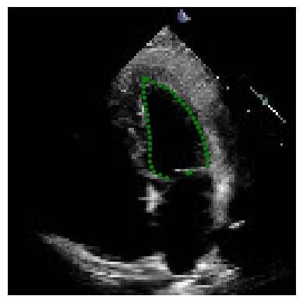
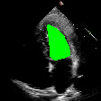
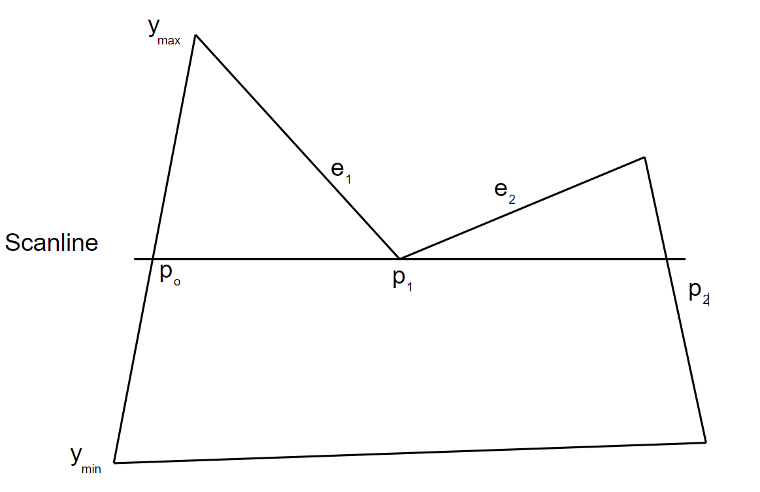
True mask algorithm
Scanline fill
This algorithm works by scanning horizontally across the image from bottom to top, identifying intersections of scanlines with polygon edges, and then filling the enclosed regions between pairs of intersecting edges. It efficiently determines the interior of the polygon and fills it with the specified color.
.
This algorithm works by scanning horizontally across the image from the bottom to the top, identifying intersections of scanlines with polygon edges, and then filling the enclosed regions between pairs of intersecting edges. It efficiently determines the interior of the polygon and fills it with the specified color. This approach is widely used due to its simplicity and effectiveness in filling polygons.

Slide 20

Detecting Left Ventricle
U-Net
The U-Net is a supervised convolutional neural network model, It excels in image segmentation due to its unique architecture with contracting and expanding paths and skip connections for preserving spatial information enabling accurate results.
.

Slide 21
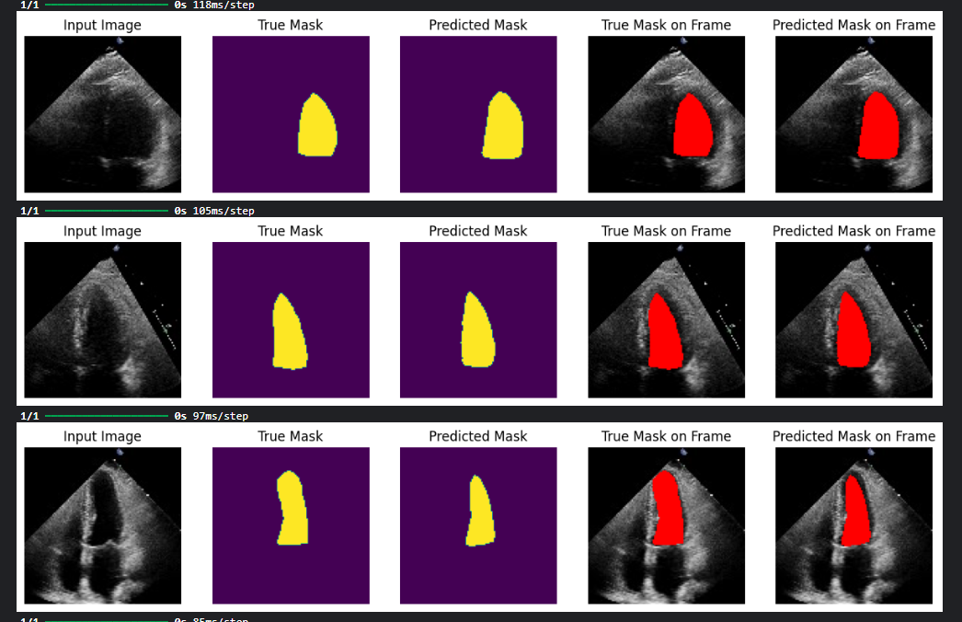
Detecting Left Ventricle cont.
U-Net (Input-True-Predicted)
.

Slide 22
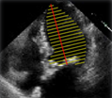
Landmarks Detection
From the predicted mask using u-Net to the left ventricle
Find the Upper Point
Determine the maximum y coordinate
Find the Bottom Point
Determine the most right and most left Then get the midpoint.
Divide the Vertical Line into 20 Discs
Add Perpendicular Lines
Ensure All Points are Within the Binary Mask
Adding Landmark Points

Slide 23
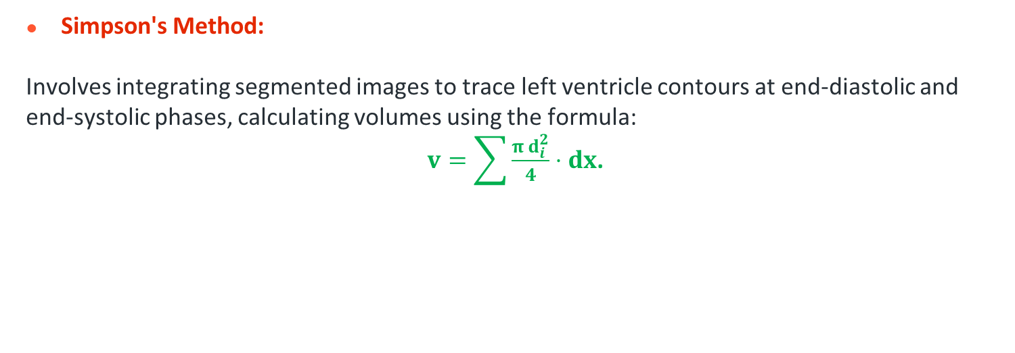
Volume Calculation
Thresholding Classification
LVEF (%) among the male population
52% to 72% normal range
41% to 51 mildly abnormal
30% to 40% moderately abnormal
Less than 30% severely abnormal
LVEF (%) among the female population
54% to 74% normal range
41% to 53 mildly abnormal
30% to 40% moderately abnormal
Less than 30% severely abnormal

Slide 24
Experimental Results
07

Slide 25
(ED-ES) Detection Results: CNN vs Transformer

Slide 26
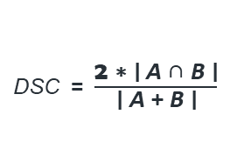
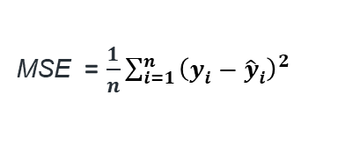
Left Ventricle Detection Results: U-Net
DSC = $\frac{\text{2 }\text{∗ }\text{∣} \text{A} \text{∩} \text{B} \text{∣​}}{\text{∣} \text{A}\text{ + }\text{B} \text{∣}}$
Dice coefficient
Mean Square Error
MSE = $\frac{1}{n}\sum_{i=1}^{n}{\text{​}{\left(y_{i}−{\hat{y}}_{i}\right)}^{2}\text{​}}$​
Segmentation | Dice-Sørensen coefficient | Mean Square Error
Segmentation Diastolic | 92.7 | 1.88
Segmentation systolic | 90.9 | 1.51
Total Average | 91.8 | 1.69

Slide 27
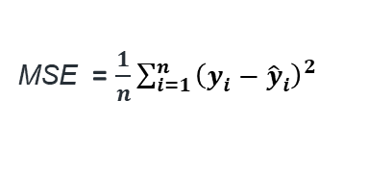
Thresholding Classification
Authors | Dataset | Pre-Processing | Boundary Box Detection | Calculate Volume | Classification Model | Evaluation
David Ouyang et al. [1] | EchoNet Dynamic Size= 10,030 | Segmentation Down Sampled (112 * 112) | _ | _ | EchoNet-Dynamic | MSE= 7.93% R2= 0.81
Hadrien Reynaud et al. [2] | EchoNet Dynamic, Size= 10,030 | _ | _ | _ | ResNet BERT | MAE= 7.85% R2 = 0.52
Grant Duffy et al. [3] | EchoNet Dynamic, Size= 10,030 | _ | _ | _ | DeepLabV3 | MAE= 8.55% R2= 0.61
Proposed System | EchoNet Dynamic, Size= 10,030 | Transformer “Detect ES,ED” | U-Net | Simpson’s Method | Thresholding | MAE= 7.7%
Mean Square Error
MSE = $\frac{1}{n}\sum_{i=1}^{n}{\text{​}{\left(y_{i}−{\hat{y}}_{i}\right)}^{2}\text{​}}$​
Ejection Fraction Mean Square Error is 7.7

Slide 28
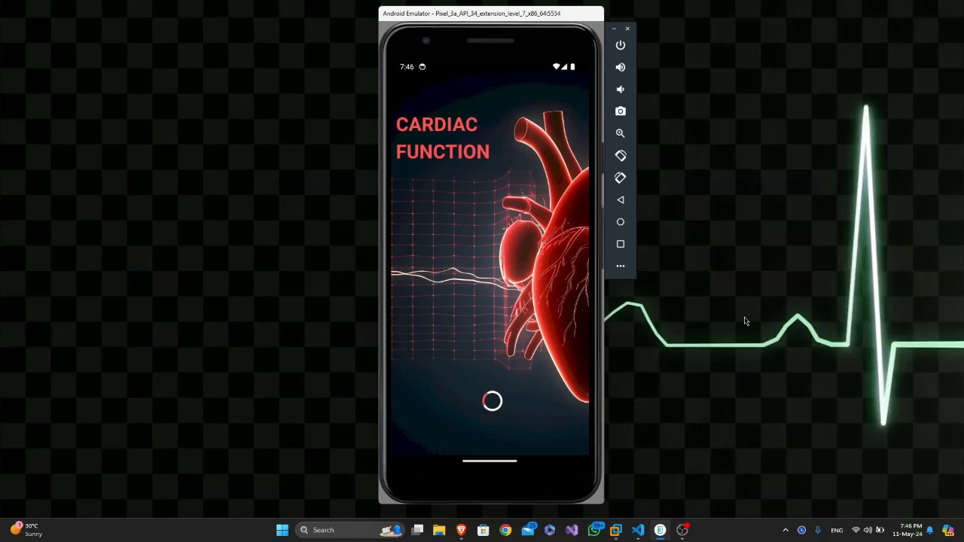
Demo

Slide 29
08
Conclusion

Slide 30
Conclusions
Accurately calculated ejection fraction for patients and, based on it, classified their condition as normal or abnormal.
Worked with different models in different phases of the system.
Achieved high results with a large dataset.
Developed an accessible and effective user interface.

Slide 31
09
Future Work

Slide 32
Future Work
The size and characteristics of the dataset influence the selection of the model, leading to potential variations in system architecture and performance outcomes.
With upcoming advancements in technology, the application will not only predict the ejection fraction but also pinpoint dysfunction within the left ventricle, potentially predicting the onset of diseases.

Slide 33
10
Tools

Slide 34




Tools
Python
Colab
Flutter
Fastapi

Slide 35
References

Slide 36
References
Ouyang, D., He, B., Ghorbani, A., Yuan, N., Ebinger, J., Langlotz, C.P., Heidenreich, P.A., Harrington, R.A., Liang, D.H., Ashley, E.A. and Zou, J.Y. Video-based AI for beat-to-beat assessment of cardiac function. Nature. 2020.
Reynaud, H., Vlontzos, A., Hou, B., Beqiri, A., Leeson, P. and Kainz, B. Ultrasound video transformers for cardiac ejection fraction estimation. In Medical Image Computing and Computer Assisted Intervention–MICCAI 2021: 24th International Conference. Springer International Publishing. Strasbourg, France. 2021. pp. 495-505.
Duffy, G., Jain, I., He, B. and Ouyang, D. Interpretable deep learning prediction of 3d assessment of cardiac function. In Pacific Symposium on BiocomputIng .2022. pp. 231-241.
Liu, X., Fan, Y., Li, S., Chen, M., Li, M., Hau, W.K., Zhang, H., Xu, L. and Lee, A.P.W.Deep learning-based automated left ventricular ejection fraction assessment using 2-D echocardiography. American Journal of Physiology-Heart and Circulatory Physiology. 2021. 321(2), pp.H390-H399.

Slide 37
Thank You

Slide 38
Any Questions ?

